Slide 1
EA Block Scheduling
Software Engineering Fall 2024
Aaron Jones, Adithi Srinath, Chengyan Tsai, Junhyuk Lee,
Mahima Kardam Bhatt, Ryann Lu, William-David Vanderpuye

Slide 2
CONTENTS
Goal
The purpose and objective of this project, including core user stories.
System Structure
An overview of the architecture or design, which is essential to understanding how the system works.
Analysis
Highlights key evaluations, such as system performance, challenges, and trade-offs made during development.
Contribution
Showcases the value added by the system, team, or individual effort in the project.

Slide 3
GOAL
The purpose and objective of this project.

Slide 4
GOAL
Our primary clients are Texas A&M Engineering Academy students across 10 academies, with key stakeholders including Austin Community College and Texas A&M University.
We are starting with the Austin A&M Academy and plan to expand the program to other academies in the future.
The program is designed to support approximately 200 students per semester on average.

Slide 5

GOAL
Our primary goal is to develop a block scheduling program for math, science, and engineering courses, allowing students to be assigned to a block schedule based on data provided through spreadsheets.

Slide 6
SYSTEM STRUCTURE
An overview of the architecture or design.

Slide 7
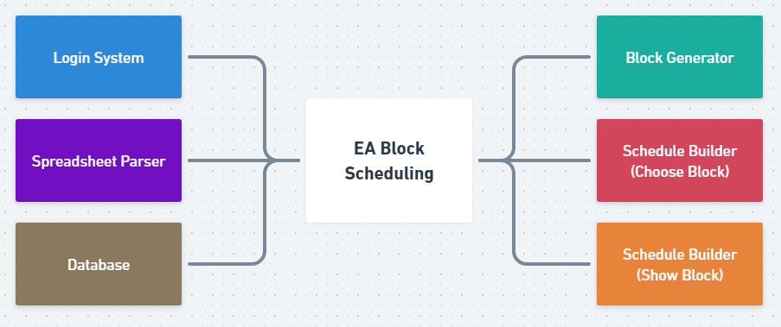
SYSTEM STRUCTURE

Slide 8
DATABASE SCHEMA
Our database primarily contains the following data:
Excel File Storage: Content, Timestamp, Name…
Block Data: ID, Course IDs, Timestamp
Course Data: ID, Term, Room, Building, Start Time, End Time, Capacity, Prerequisites
User Data: UID, Email, Name, Role

Slide 9

LOGIN SYSTEM
The system supports Single Sign-On (SSO) using Gmail, streamlining user authentication. Key implementation details include:
SSO Functionality: Enables users to log in seamlessly via their Gmail accounts.
OAuth Integration: Utilized the OmniAuth Ruby gem to handle authentication securely.
Credential Setup: Configured necessary credentials to facilitate user sign-ins.

Slide 10
SPREADSHEET PARSER
Upload Functionality:
Admins can upload Excel files via a dedicated page with a styled upload button.
Uploaded files are parsed and persisted in the database.
File Management:
Uploaded files are displayed with their name, a downloadable link, and an option to delete them.
Admins can download or delete files directly from the interface.

Slide 11
BLOCK GENERATOR
Admin Features:
Set Typical Class Groupings: Admins define typical class groupings to generate draft blocks.
Set Block Generation Conditions: Admins specify prerequisites and block conditions directly in the web application.
Block Generation:
Algorithm Implementation: Developers created algorithms to apply block generation conditions and automatically generate possible blocks.

Slide 12
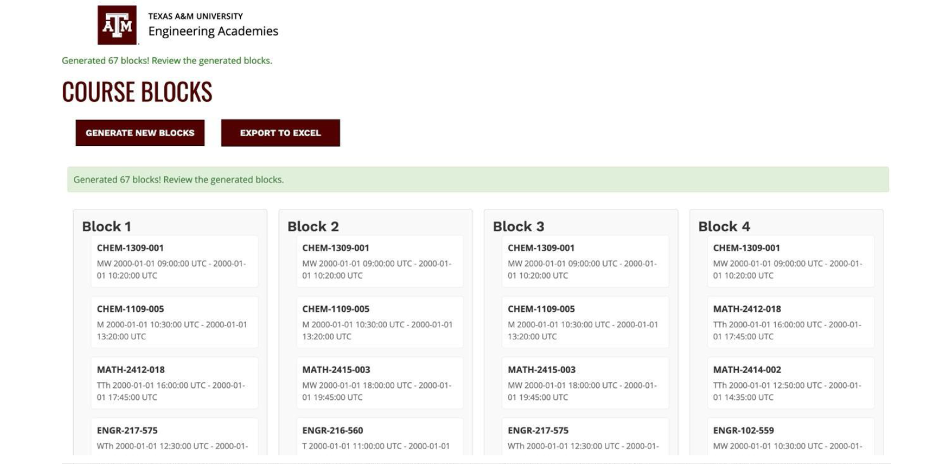
BLOCK GENERATOR

Slide 13
BLOCK GENERATOR
User Interaction:
Users can select blocks, check prerequisites, and view detailed class information, including:
Start and End Times
Instructor Details
Room Information
Prerequisite
Alerts and warnings notify users if selected blocks are unavailable or violate schedule limits.

Slide 14
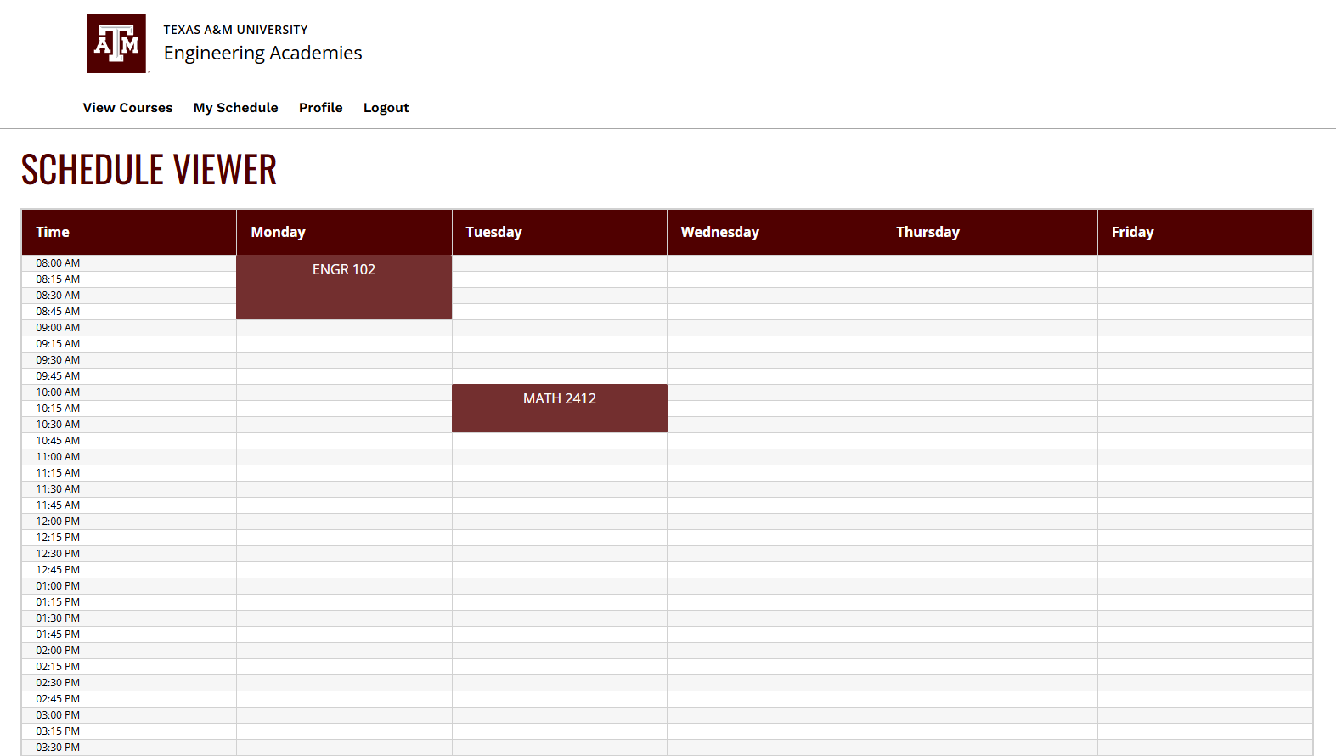
SCHEDULE VIEWER
Time Unit: Classes are organized in 15-minute intervals.
Interactive Blocks: Users can click on any class block to view detailed information about the class.

Slide 15
ANALYSIS
Highlights key evaluations.

Slide 16
Development Process
Sprint 1
Sprint 2
Sprint 3
Sprint 4
Generate Schedule Page
Add a landing page
Initialize the Ruby on Rails repo and configure Cucumber
Deploy the app to Heroku
DB schema discussion
UI mockup discussion
Make each classes object
Upload the excel spreadsheet
Integrate Code climate to repo
UI Mock-up
System Structure Diagram
Store the spreadsheet data on the database
Add tokens for logging in
Add SSO Capability
Connect login page to student dashboard
Set block generating conditions on the web
Display Class Blocks
Student and Admin views
Retrieve data from database
Application makes possible blocks with conditions
Generate possible blocks
Add prerequisite and type column to course table for schedule generation
UI Refinement
Bug Fix - Dashboard

Slide 17
OUR LESSONS
User stories focus on understanding the user's needs and motivations, enabling the development team to prioritize features that deliver maximum value to the end-user.
User Stories
During our development process, we accidentally lost some progress due to a revert. So we suggest everyone frequently save your progress on your dev branch, and make reverts more carefully.
Dev Branch
Writing tests can take significant time, especially for complex scenarios. When user stories or requirements evolve, existing tests may no longer be valid.
Cons of TDD

Slide 18
TODO
User Profile
UI Refinement
User can edit more information through the profile page.
UI can still be improved.
Schedule Viewer Integration
Announcement System
The schedule viewer is not yet integrated with the block generator.
Admins can post announcements through the block scheduling system to ensure students receive important messages promptly.
Schedule Builder
Responsive Web Design
Students can see the blocks available for this semester but the system cannot store their choices yet. Admin may view their choices.
Make sure web pages render well on a variety of devices.

Slide 19
CONTRIBUTION
Highlights key evaluations.

Slide 20
OUR MEMBERS
Aaron Jones
Adithi Srinath
Chengyan Tsai
Junhyuk Lee
Sprint 2 Scrum Master
Debugging, testing, system refinement, UI implementation, database schema, demo video
Sprint 4 Scrum Master
Debugging, testing, system refinement, login system, documentations, database schema, code climate, repo init
Sprint 1 Scrum Master
Sprint 2 Product Owner
Debugging, testing, management, UI mock-ups, system design, schedule viewer, documentations
Sprint 4 Product Owner
Debugging, testing, block generator and algorithm design
Mahima Kardam Bhatt
Ryann Lu
William-David Vanderpuye
Sprint 3 Scrum Master
Debugging, testing, spreadsheet parser, data storage , documentations, database schema
Sprint 1 Product Owner
Block generator and algorithm design, meeting minutes
Sprint 3 Product Owner
Login system, documentations

Slide 21
THANK YOU!
Any Questions?
PowerPoint by Chengyan Tsai

